Slide 1
SQL
Structured Query Language

Slide 2
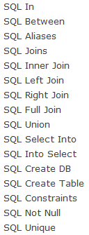
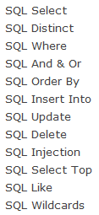

Slide 3
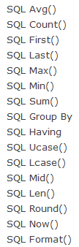
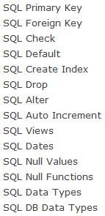

Slide 4
Basic Queries in SQL
SQL has only one basic statement to retrieve information
  SELECT
  FROM
  WHERE

Slide 5
The Select-From-Where Structure of SQL Queries
General Form:
  SELECT <attributes list>
  FROM <tables list>
  WHERE <condition>;

Slide 6
SELECT Operator

Slide 7
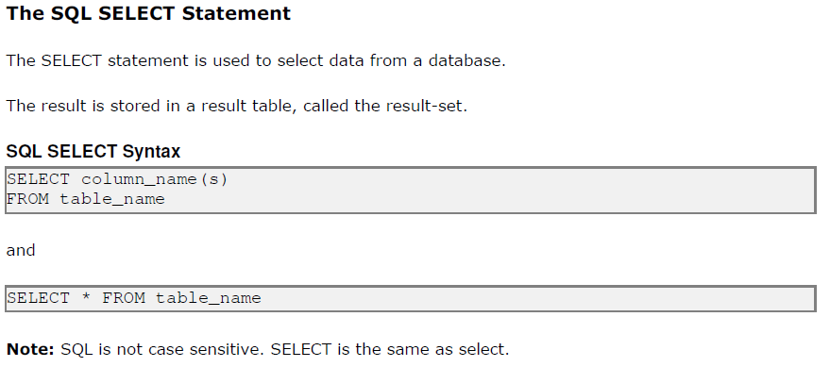

Slide 8
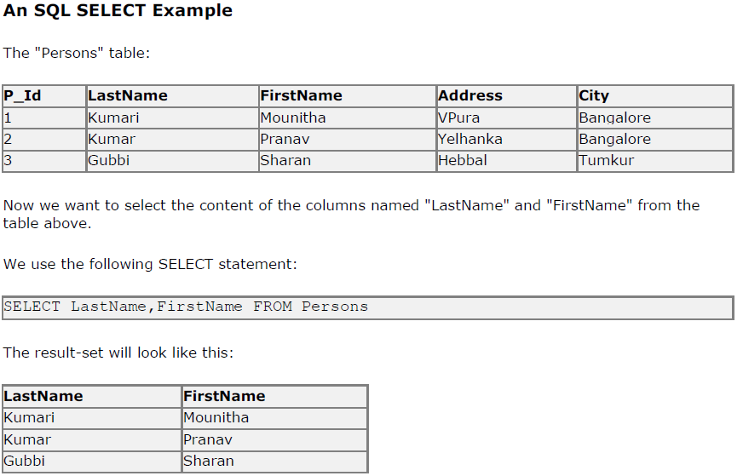

Slide 9
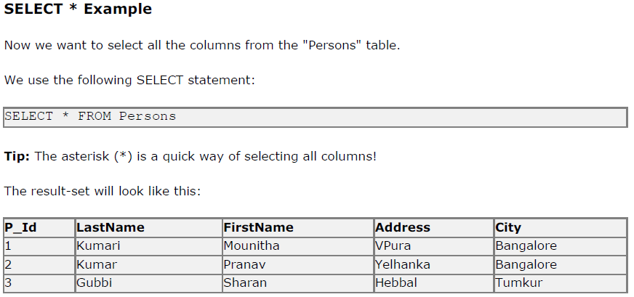

Slide 10
DISTINCT Statement

Slide 11
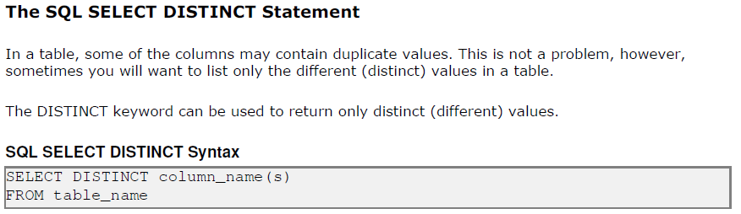

Slide 12
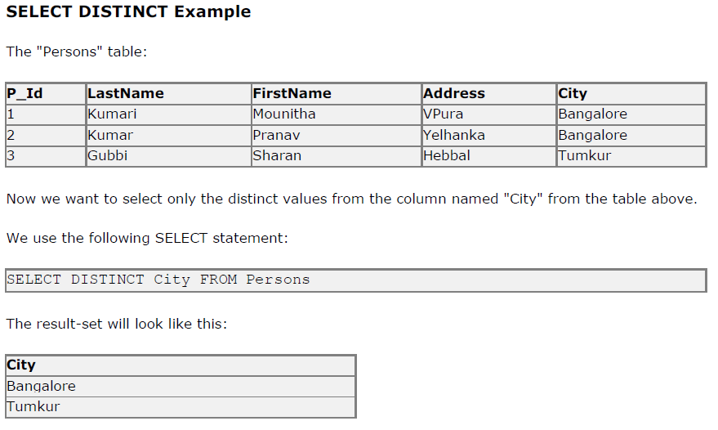

Slide 13
WHERE Clause

Slide 14
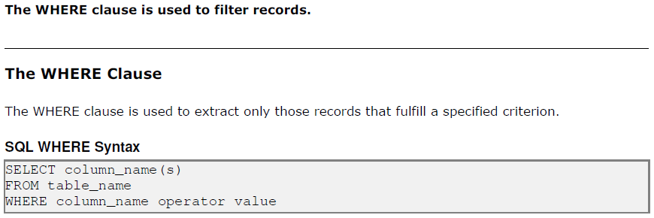

Slide 15
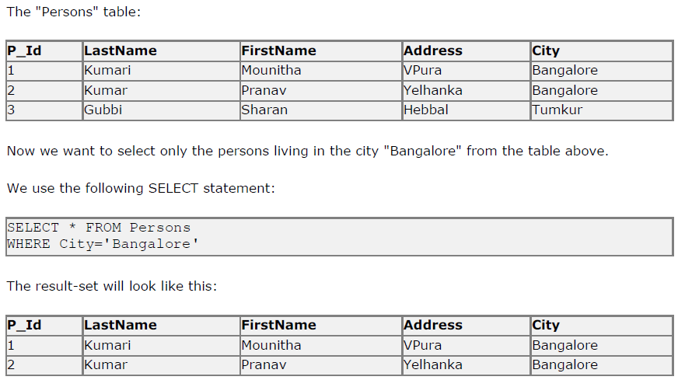

Slide 16
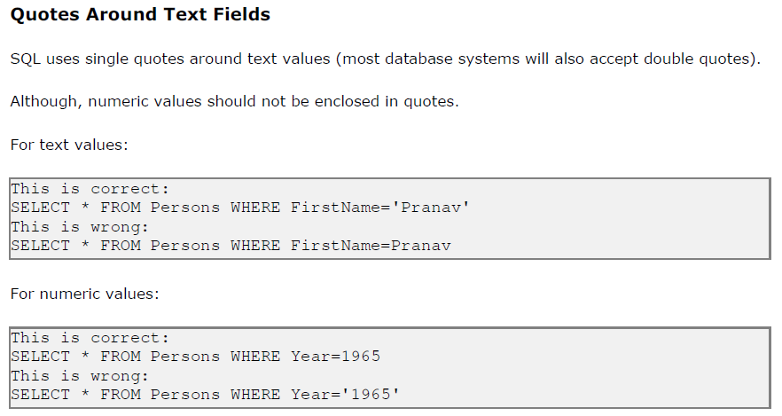

Slide 17
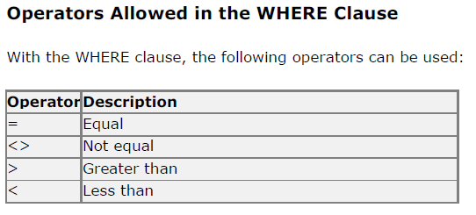
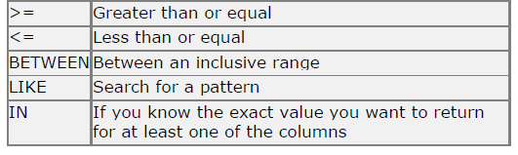

Slide 18
AND, OR Operator

Slide 19
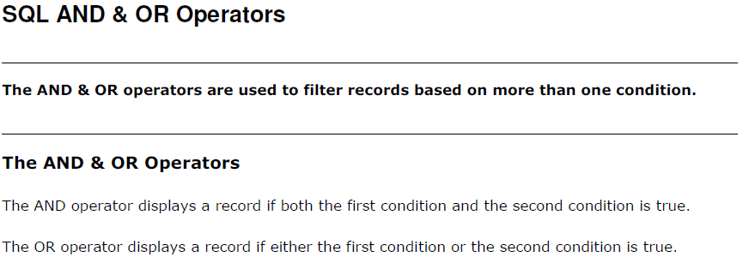

Slide 20
x | y | x AND y | x OR y | Not x
TRUE | TRUE | TRUE | TRUE | FALSE
TRUE | UNKNOWN | UNKNOWN | TRUE | FALSE
TRUE | FALSE | FALSE | TRUE | FALSE
UNKNOWN | TRUE | UNKNOWN | TRUE | UNKNOWN
UNKNOWN | UNKNOWN | UNKNOWN | UNKNOWN | UNKNOWN
UNKNOWN | FALSE | FALSE | UNKNOWN | UNKNOWN
FALSE | TRUE | FALSE | TRUE | TRUE
FALSE | UNKNOWN | FALSE | UNKNOWN | TRUE
FALSE | FALSE | FALSE | FALSE | TRUE

Slide 21
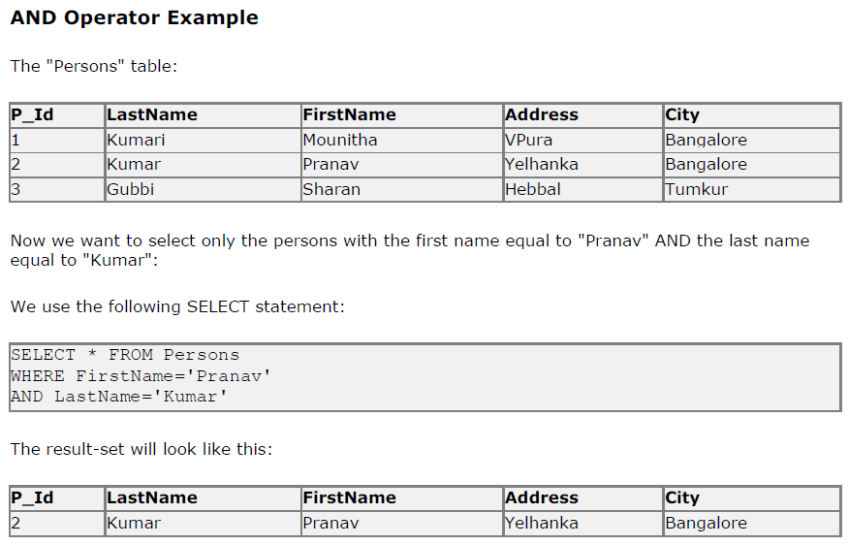

Slide 22
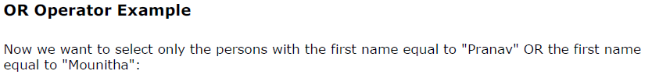
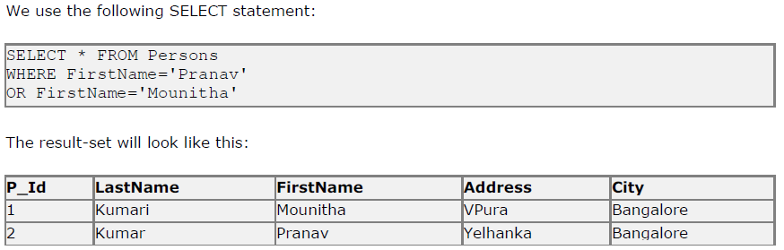

Slide 23
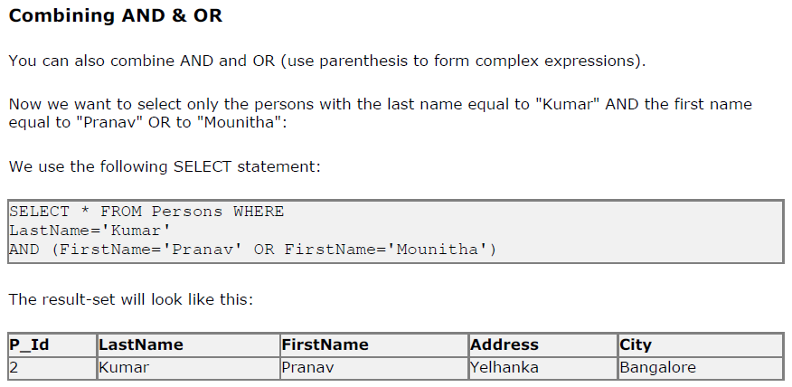

Slide 24
ORDER BY Keyword

Slide 25
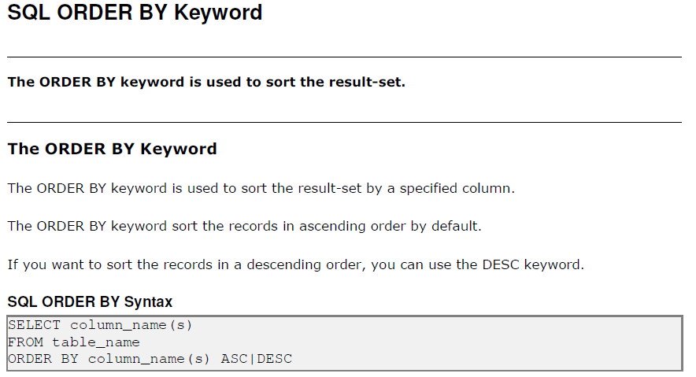

Slide 26
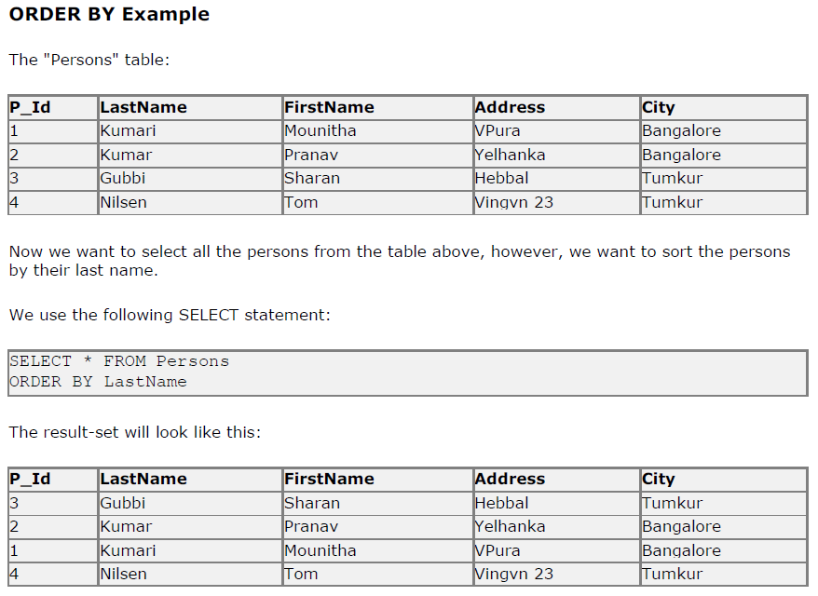

Slide 27
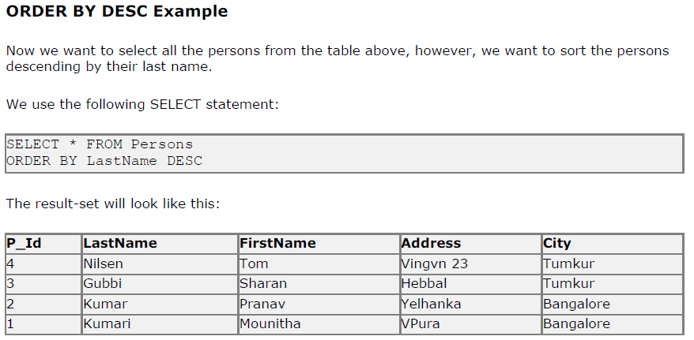

Slide 28
INSERT INTO Statement

Slide 29
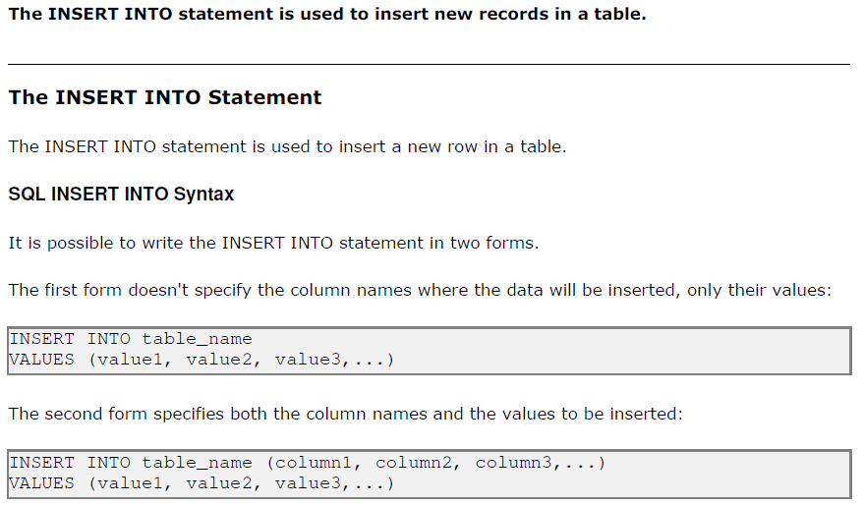

Slide 30
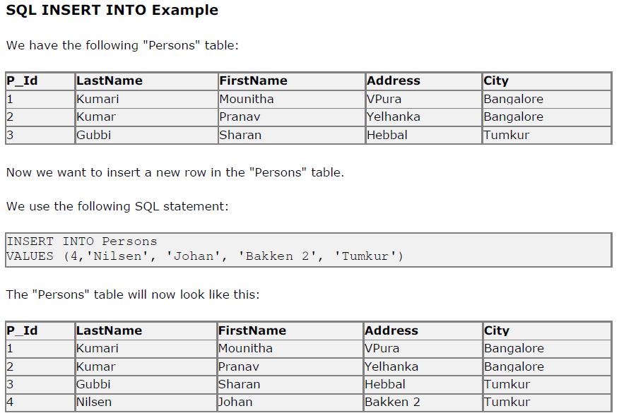

Slide 31

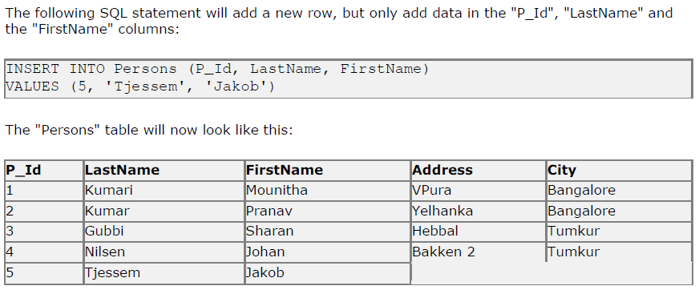

Slide 32
UPDATE Statement

Slide 33
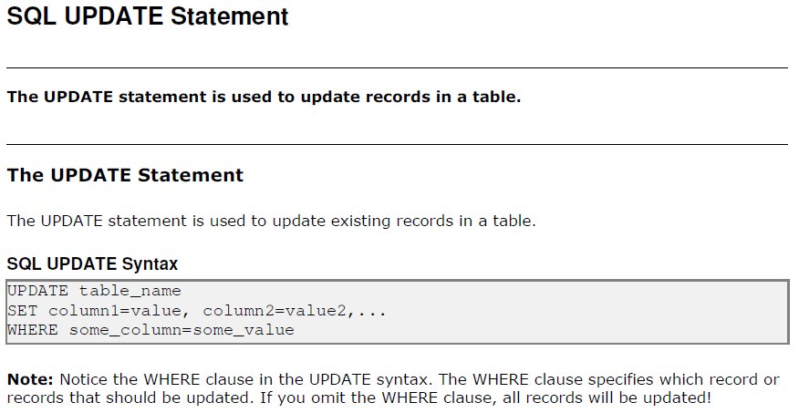

Slide 34
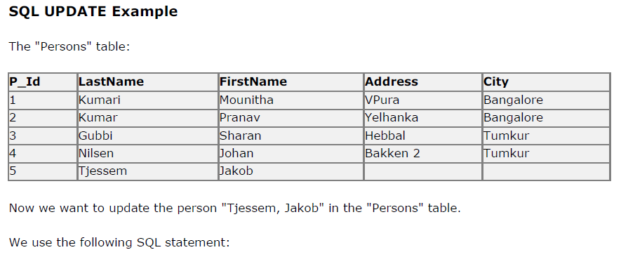
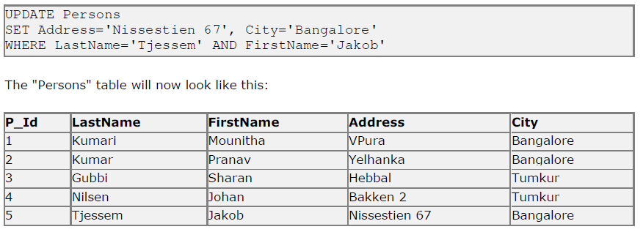

Slide 35
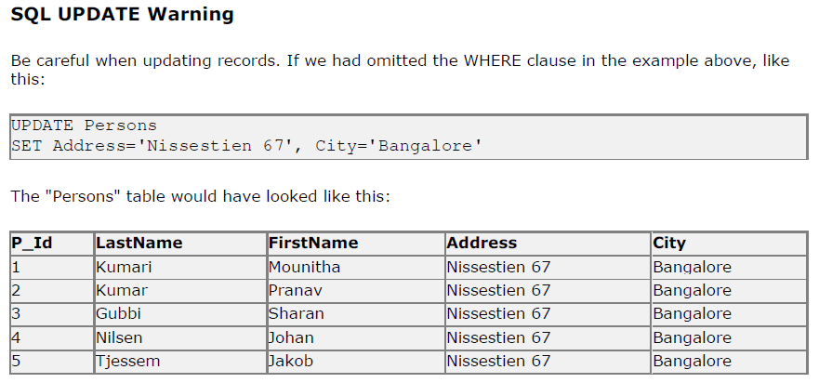

Slide 36
DELETE Statement

Slide 37
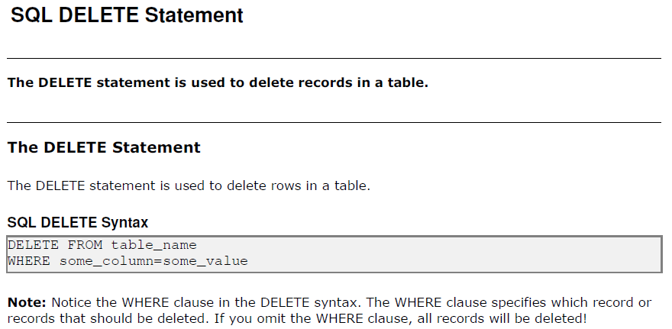

Slide 38
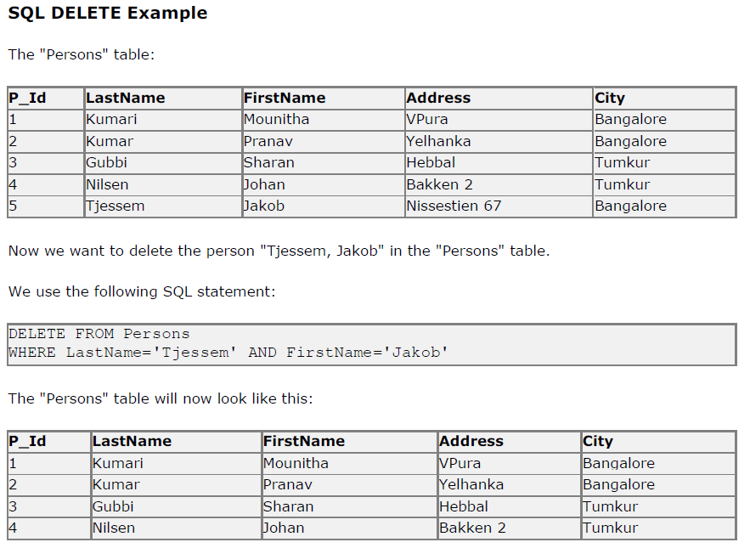

Slide 39
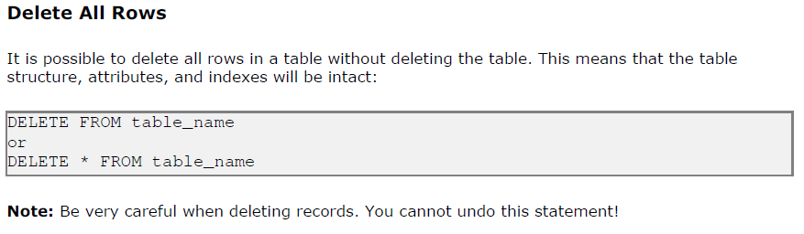

Slide 40
TOP Clause

Slide 41
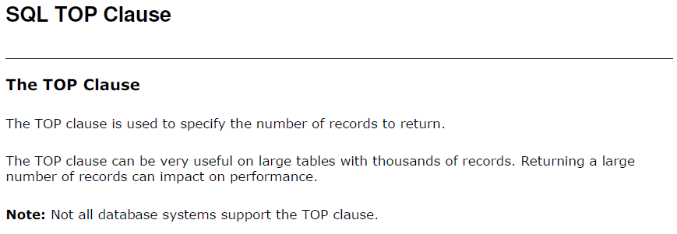
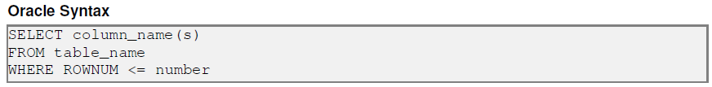
MYSQL Syntax
SELECT TOP ROWNUM COLUMN_NAME(S)
FROM TABLE NAME

Slide 42
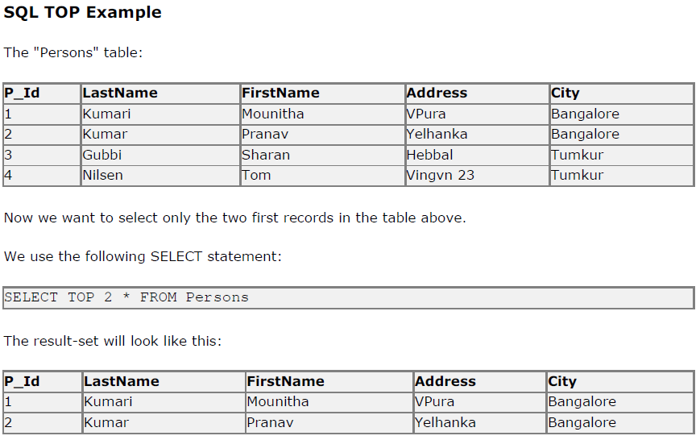

Slide 43
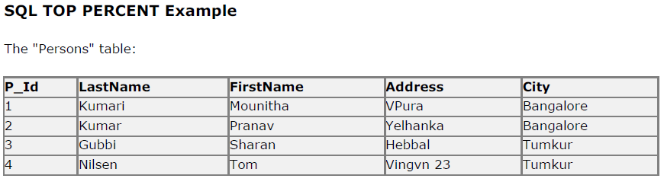
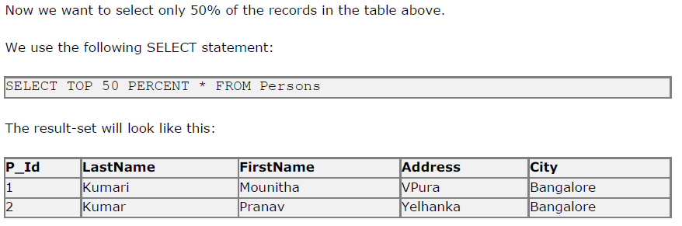

Slide 44
LIKE Operator

Slide 45
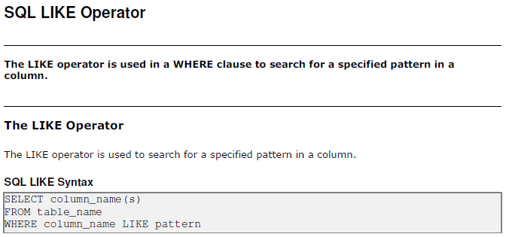

Slide 46
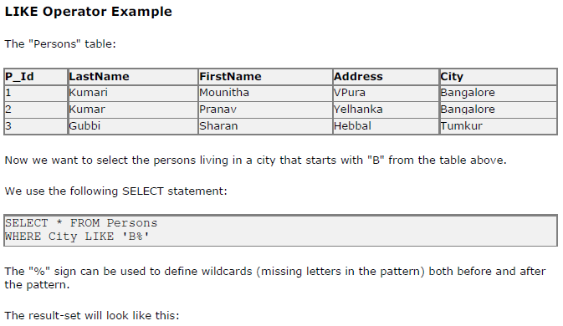


Slide 47
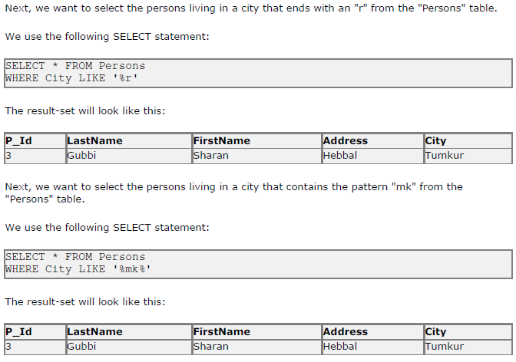

Slide 48
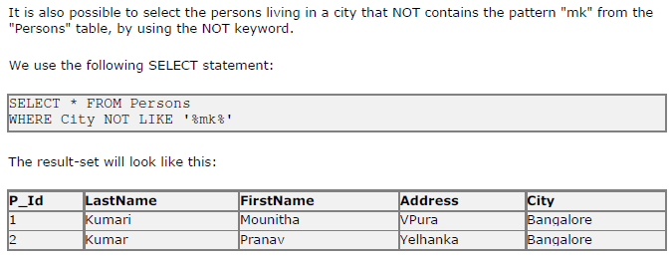

Slide 49
WILDCARDS

Slide 50

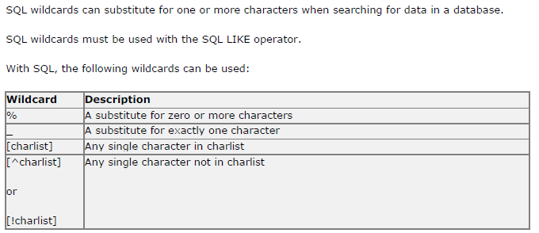

Slide 51
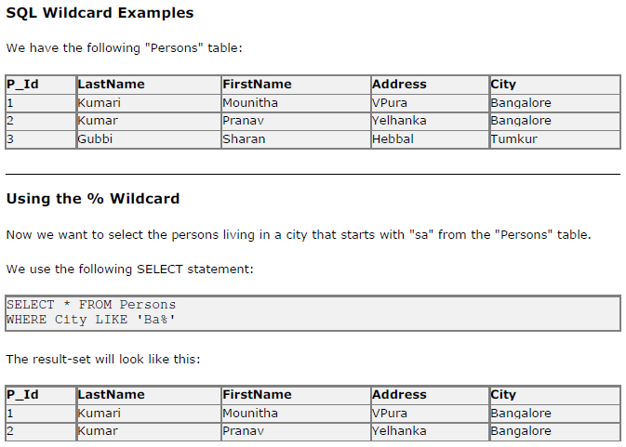
Ba

Slide 52
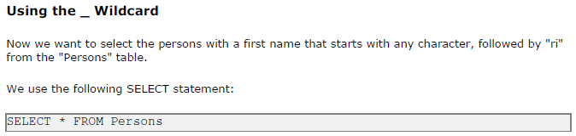
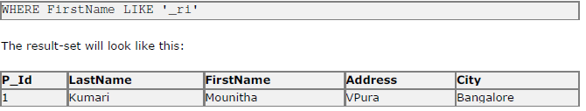
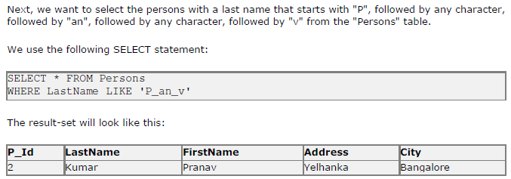
And total number of characters are 6.
Where last name like ‘____ri’

Slide 53
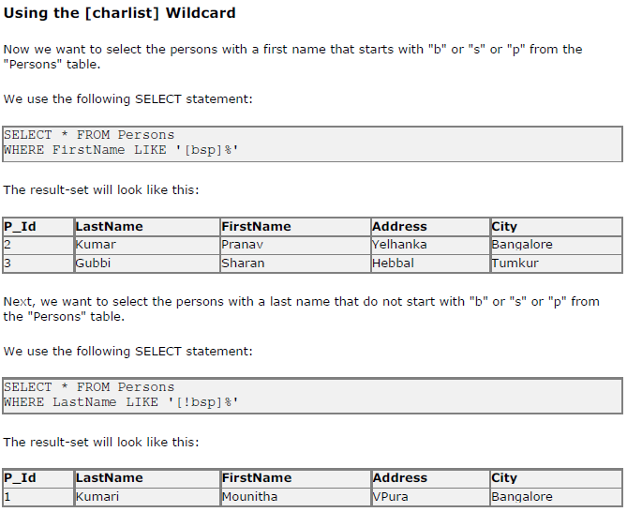

Slide 54
IN Operator

Slide 55
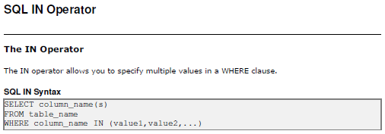

Slide 56
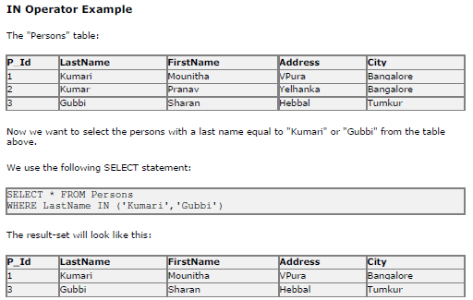

Slide 57
BETWEEN Operator

Slide 58
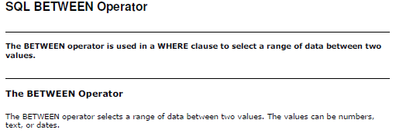


Slide 59


Slide 60



Slide 61
ALIAS

Slide 62


Slide 63



Slide 64

AND
AND

Slide 65
JOIN Operator

Slide 67



Slide 68


Slide 69


Slide 70
LEFT JOIN Keyword

Slide 71


Slide 72


Slide 73


Slide 74


Slide 75


Slide 76


Slide 77


Slide 78
UNION Operator

Slide 79


Slide 80





Slide 81
Aggregate Functions

Slide 82


Slide 83



Slide 84


Slide 85



Slide 86


Slide 87



Slide 88



Slide 89


Slide 90



Slide 91
Last()
First()
SELECT column_name FROM table_name
ORDER BY column_name ASC
WHERE ROWNUM <=1;
SELECT column_name FROM table_name
ORDER BY column_name DESC
WHERE ROWNUM <=1;

Slide 92


Slide 93


Slide 95



Slide 96
kumari
kumar
gubbi

Slide 97


Slide 99

Oracle Syntax
SELECT SUBSTR(City,1,4) From Persons;

Slide 100


Slide 101
Oracle Syntax
SELECT Length(Address) From Persons;

Slide 102



Slide 103


Slide 104


Slide 105


Slide 106
CREATE BACKUP and RESTORE

Slide 107
BACKUP: mysqldump --opt -u [uname] -p[pass] [dbname] > [backupfile.sql]
Exmple: mysqldump –u root –p lab1>lab1_backup.sql
RESTORE: mysqldump --opt -u [uname] -p[pass] [dbname] < [backupfile.sql]
Exmple: mysqldump –u root –p lab1<lab1_backup.sql

Slide 108


Slide 109
CREATE TABLE Statement

Slide 110


Slide 111
CONSTRAINTS

Slide 112


Slide 113



Slide 114


Slide 115



Slide 116


Slide 117



Slide 118


Slide 120


Slide 121


Slide 122


Slide 123
CREATE VIEW

Slide 124



Create View
SELECT * FROM View_Person WHERE Id BETWEEN 4 AND 8;
Oracle will transform the query as follows :
SELECT * FROM (SELECT * FROM PersonInfo Where City Not In ('LUCKNOW', 'DELHI')) WHERE Id BETWEEN 4 AND 8;
    CREATE VIEW View Name AS (SELECT column_name(s) FROM Table_Name);
CREATE VIEW View _Person AS SELECT * FROM PersonInfo Where City Not In ('LUCKNOW', 'DELHI');
SELECT * FROM View_Person;

Slide 125



